Slide 1
Training of Trainers
Unit 4 - VET-Business cooperation

Slide 2



Contextualisation of the unit
The fourth unit focus on the document “Quality Framework for the Cooperation in VET System”, providing some guidelines and showing good practices for the establishment, maintenance and reinforcement of VET-Business cooperation, essential to keep updated the identification of the most relevant soft skills for young qualified workers.
Duration of 1h30m
On successful completion of this unit participants will be able to:
  Know and understand the relevance of the VET-Business cooperation to match the labour market needs;
  Identify good practices of VET-Business cooperation;
  Define a strategy to the establishment and strengthen of VET-Business cooperation.
The unit comprises the following topics:
  Quality Framework for the Cooperation in VET System
  Introduction
  VET-Business Cooperation
  How to promote VET-Business cooperation?
  Which strategies, initiatives and practices exist?

Slide 3
Quality Framework for the Cooperation in VET System

Slide 4

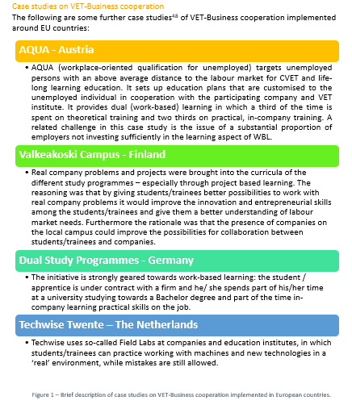
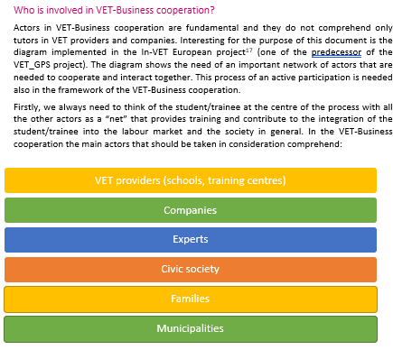
Quality Framework for the Cooperation in VET System
What is the objective of the document?
Quality Framework for the Cooperation in VET System was structured to provide an overview related to:
  The presence of soft skills on VET curricula
  The relevance of VET-Business cooperation
  The conditions, criteria and strategies to promote and strengthen VET-Business cooperation
  Good practices, at National and European levels, of VET-Business cooperation that can inspire VET providers and SME.
The document was designed for providers and SMEs.
* VET_GPS partnership. (2019). Quality Framework for the cooperation in VET System. Available here .

Slide 5




Quality Framework for the Cooperation in VET System
How is it structured?
The document is organised in four main sections:
Introduction
VET-Business cooperation
Focused on the relevance of the VET-Business cooperation, on the key-actors and their roles to a successful cooperation, identifying national policies to promote it.
How to promote VET-Business cooperation?
Brief description of the conditions, professionals and strategies for the establishment, reinforcement and strengthen VET-Business cooperation.
Which good practices exist?
Focus on an analysis of the integration of the soft skills in the VET curricula and the relevance of VET training to the success in the labour market
In this section are provided examples of successful VET systems in Europe and of the integration of soft skills in VET curricula, identifying relevant projects and initiatives.
* VET_GPS partnership. (2019). Quality Framework for the cooperation in VET System. Available here .

Slide 6
Introduction

Slide 7
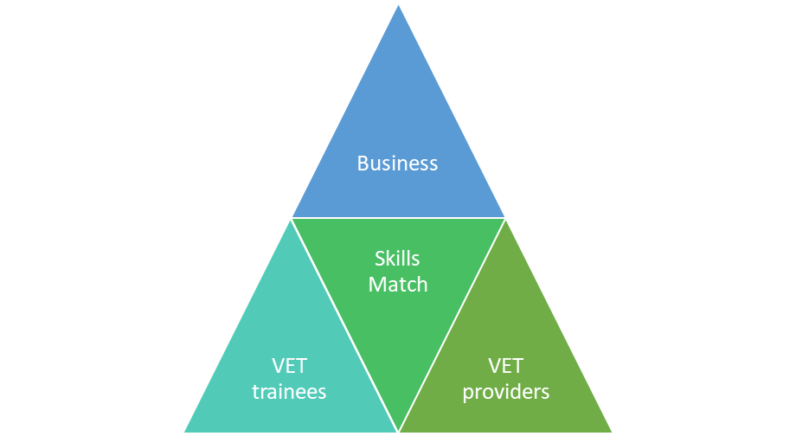
Introduction
Why are soft skills important?
Employers are considering soft skills as the main factor during the hiring process;
VET providers are engaging in delivering educational programmes focused more on soft skills due to the demand of the job market;
These new developments requires a good match between the demands of the labour market and the skills acquired and developed by young trainees and potential employees;
A good match between supply and demand is important for all actors involved:
A good match makes them able to adapt to new developments and/or to create innovation.
A good match increases their job opportunities on the labour market.
Which can benefit from a good match for the attractiveness of their education.
* VET_GPS partnership. (2019). Quality Framework for the cooperation in VET System. Available here .

Slide 8
Introduction
Why look at Vocational Education and Training?
VET learning experience can lead to different social outcomes
Impact on Skills and Competences
- increase of learner confidence, self-esteem and desire for education;
- development of their professional identity, enabling individuals to take control of their work life and also to influence conditions in the workplace.
Relationship with other individuals
- “capability to help the development of network between learners and between learners and teachers, mentors, masters and employers”;
- VET are based on socialisation, through the transmission of attitudes and behaviours.
Potential for success in the labour market
- leading and facilitating students and trainees’ possibility of success in the labour market, with access, integration, stability and mobility
* VET_GPS partnership. (2019). Quality Framework for the cooperation in VET System. Available here .
** European Union. (2018). Mapping of VET graduate tracking measures in EU Member States - Final Report. Accessed on 15th of March 2019, available here.

Slide 9
Introduction
The OECD** carried out an analysis on the need of VET education in Europe answering to two main questions:
Why look at Vocational Education and Training?
- global economic competition; - competition on the quality of goods and services; - labour force with a range of mid-level trade, technical and professional skills.
Why is initial Vocational Education and Training needed?
- Focused on the development of competences;
- combination of formal and non-formal learning;
- combine training in classes with training at the workplace.
* VET_GPS partnership. (2019). Quality Framework for the cooperation in VET System. Available here .
** Organisation for Economic Co-operation and Development. (2011). OECD reviews of vocational education and training – Pointers for policy development. Accessed on 10th April 2019, available here.

Slide 10
VET-Business Cooperation

Slide 11
VET-Business Cooperation
Why is VET-Business cooperation important?
Who is involved in VET-Business cooperation?
Reduce the gap between the trainees’ competences acquired in VET courses and the needs & trends of the companies;
Endow both organisations, VET providers and companies, of responsibility to assure a high-quality initial training of young people;
Prepare young people to be successfully integrated in the company and manage their career development.
VET providers (schools, training centres)
Companies
Experts
Civic society
Families
Municipalities
* VET_GPS partnership. (2019). Quality Framework for the cooperation in VET System. Available here .

Slide 12
VET-Business Cooperation
All these actors can have a major or minor role. More precisely we can divide the VET-Cooperation in 4 main levels:
VET schools and/or training centres represent the first actor in place since they are in direct contact with the trainee and get to know the needs of the students/trainees and their strengths and weaknesses.
A second level of cooperation is represented by the interaction by VET schools and companies. This is the most important aspect of the VET-Business cooperation because it is where companies and VET schools work together through different programmes through which students/trainees can acquire and improve their knowledge and competences.
the last two levels regard cooperation among VET providers and companies with the help of other organisations and the civic society that can be families, municipalities and experts in the education and job field.
School/
Training Center
School - Company
School – Company – Other organisation
School – Company – Other organisation - civic society
* VET_GPS partnership. (2019). Quality Framework for the cooperation in VET System. Available here .

Slide 13
VET-Business Cooperation
How do national policies contribute to VET-Business cooperation?
The document named “Bruges Communiqué ” released by the European Ministers for Vocational Education and Training, the European Social Partners and the European Commission for the period 2011-2020 deals with the issue of policies implementation in the VET sector.
Taking into account the priorities and overall objectives of the above-mentioned European Strategy and Framework, and respecting the principle of subsidiarity, the following is adopted:
A global vision for VET in 2020
11 strategic objectives for the period 2011-2020 based on that vision
22 short-term deliverables at national level for the first 4 years (2011-2014), with indication of the support at EU level
General principles underlying the governance and ownership of the Copenhagen Process
VET_GPS partnership. (2019). Quality Framework for the cooperation in VET System. Available here .
** European Ministers for Vocational Education and Training, European Social Partners & European Commission. (2010). The Bruges Communiqué on enhanced European Cooperation in Vocational Education and Training for the period 2011-2020. Accessed on 15th of March 2019, available here.

Slide 14
How to promote VET-Business cooperation?

Slide 15
How to promote VET-Business cooperation?
Which professionals need to be involved and how?
The main experts in the field for a qualified cooperation between VET and business are teachers (VET providers) and trainers (in company).
The European Commission released a document presenting 12 policy pointers which aims at helping and supporting teachers and trainers, gathered in four main areas of action (which for each of them a case study is provided to have a practical example):
Specifying the roles and responsibilities of teachers and
trainers in VET systems
Strengthening the professional development of teachers and
trainers
Equipping teachers and trainers
for key challenges
Fostering collaboration to support
their work
* VET_GPS partnership. (2019). Quality Framework for the cooperation in VET System. Available here .
** S.D. Broek, M. Cino Pagliarello, R. de Vreede-Van Noort, P. Vroonhof. (2017). Teachers and trainers in work-based learning/apprenticeships - of models and practices Final report Request for Services VT/2015/075 In the Context of EAC-47-2014-4. Accessed on the 29th August 2019, available here.

Slide 16
How to promote VET-Business cooperation?
Which strategies and initiatives need to be implemented for establishing or strengthen VET-Business cooperation?
Mutual interest in taking part in collaboration;
Both parties need to contacting different terminologies and concepts;
Clarity on settling and sharing educational/training goals;
Trainee must be involved in the definition of the educational objectives and teaching methods of the traineeship;
Define a common strategy and a structured plan, defining:
The modalities of the collaboration
The roles of the people involved
The number of trainees involved and the most useful profiles
The criteria for choosing candidates
Intermediate and final evaluation criteria
* VET_GPS partnership. (2019). Quality Framework for the cooperation in VET System. Available here .
** S.D. Broek, M. Cino Pagliarello, R. de Vreede-Van Noort, P. Vroonhof. (2017). Teachers and trainers in work-based learning/apprenticeships - of models and practices Final report Request for Services VT/2015/075 In the Context of EAC-47-2014-4. Accessed on the 29th August 2019, available here.

Slide 17
Which strategies, initiatives and practices exist?

Slide 18

Which strategies, initiatives and practices exist?
A challenge for you!
In small groups, discuss about strategies, initiatives and practices that you know to strengthen the VET-Business cooperation. You will have 10 minutes to exchange ideas.
Write down the ideas of the group in a paper provided by the trainers.
Share your ideas with the other groups and settle conclusions.

Slide 19
Final remarks

Slide 20
Final remarks
Unit summary
Quality Framework for the Cooperation in VET System
Introduction
VET-Business Cooperation
How to promote VET-Business cooperation?
Which strategies, initiatives and practices exist?

Slide 21


Final remarks
Recommended Reading
VET_GPS partnership. (2019). Quality Framework for the cooperation in VET System. Available here.
European Union. (2018). Mapping of VET graduate tracking measures in EU Member States - Final Report. Accessed on 15th of March 2019, available here.
Organisation for Economic Co-operation and Development. (2011). OECD reviews of vocational education and training – Pointers for policy development. Accessed on 10th April 2019, available here.
Business Europe. (2012). Creating Opportunities for Youth: How to improve the Quality and Image of Apprenticeships. Accessed on 27th August 2019, available here.
Other documents, sources and websites are introduced in the full document.

Slide 22
  Contact: (organisation, country, person and contacts)
  Website: https://www.vetgps.eu
  Facebook page: https://www.facebook.com/VETGPS.eu/

